Slide 1
Inceptez Property Interaction Estimation
Presented By
Aswin Raam

Slide 2
Inceptez Property Interaction Estimation
My Understanding of the Requirement
Here, we are given a dataset of details of various real estate properties being listed and the enquiries which have been made on them over a period of time.
Now, we are expected to predict the frequency in which a property would be enquired right from the day it is listed.

Slide 3
EDA INSIGHTS

Slide 4
Univariate Analysis

Slide 5
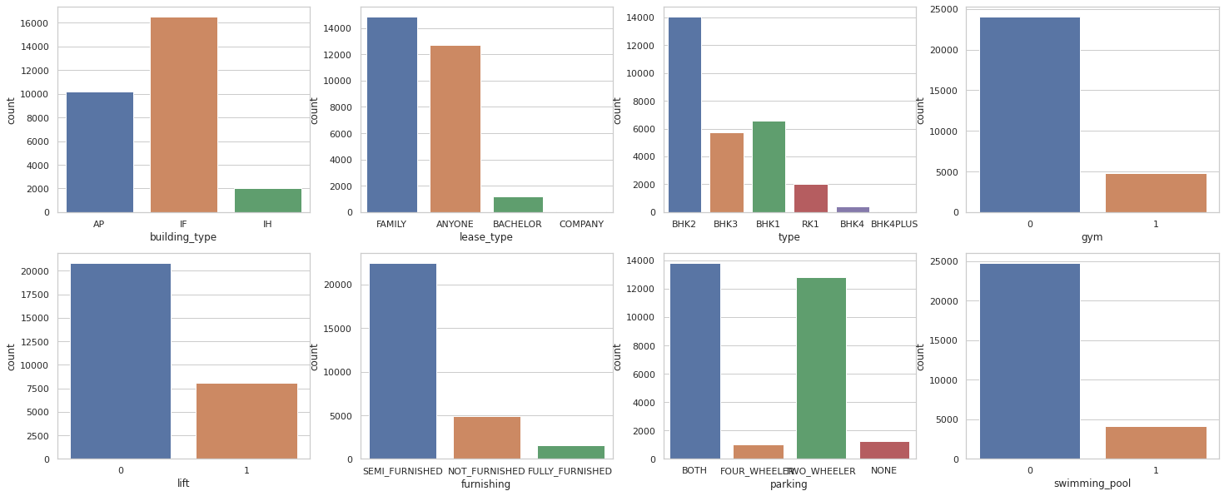

Slide 6
Univariate analysis Insights
Individual Flats are listed more
Properties are leased more to family
2BHK Properties are listed more
Most of the properties listed do not have amenities like gym,lift,pool
Semi furnished properties are highly listed
Properties having both 2wheeler and 4-wheeler parking facilities are highly listed

Slide 7
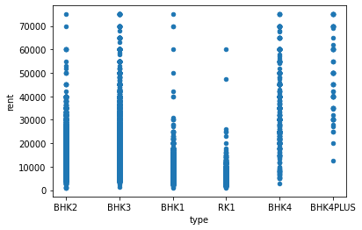
The inference taken from this scatterplot is that 3BHK and 4BHK properties have high rents which is quite obvious

Slide 8
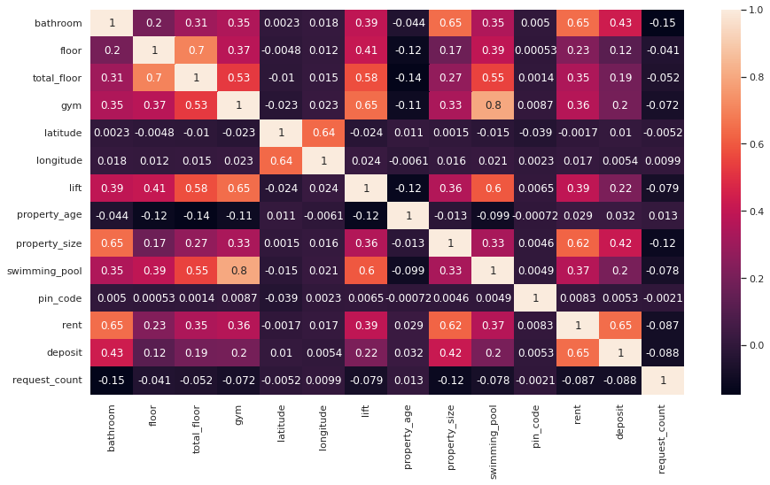

Slide 9
Heatmap Insights
Bathroom and rent are highly +ve correlated
Property size and rent are highly +ve correlated
Gym,lift,swimming pool,floor are highly +ve correlated to total floor
Rent and deposit are highly +ve correlated
Gym and swimming pool are highly +ve correlated

Slide 10
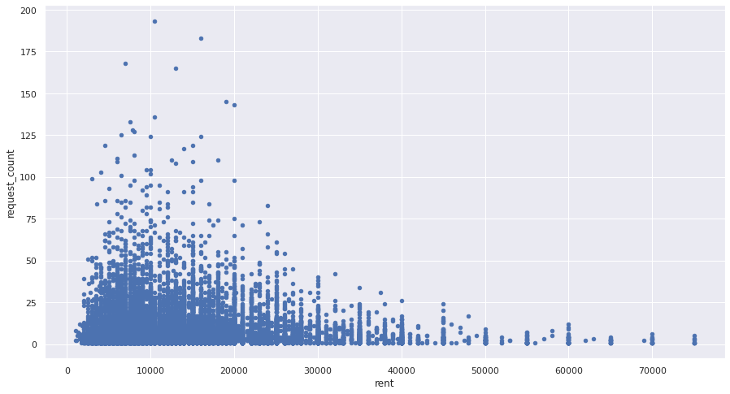
More enquiries were made for houses having rent ranging between 1000 - 20000

Slide 11
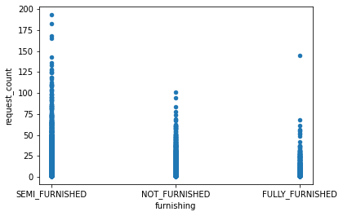
Semifurnished houses are enquired more comparitively

Slide 12
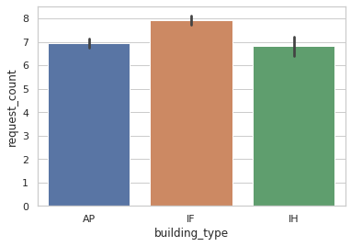
Individual flats are highly enquired about.

Slide 13
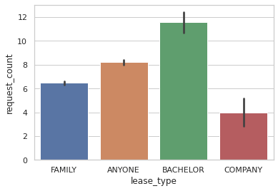
Properties which lease to Bachelors are highly enquired

Slide 14
Recommendations for a property to achieve a good Interaction Score
Rent could be ranging from 1000 - 20000
The property could be atleast semi-furnished
The property could be leased to Bachelors or anyone and not specific
The property could be an individual flat

Slide 15
Things a property should avoid getting a poor interaction score
The property cannot have a high rent
The property cannot have specific lease type and be open to all

Slide 16
Defining the Target Variable
Since the target variable was not given, the total number of enquiries made for a property is calculated and taken as the ‘Request_count’ for a particular property which can be considered as the target variable.

Slide 17
Data Insights
None of the columns had more than 30% missing values
So, no columns having null value were dropped. Instead, they have been filled with mode and mean values accordingly
The column ‘ Bathroom’ had been dropped since it gave a VIF score of 14 which is greater than the cutoff
The columns ‘Latitude’,’Longitude’ and ‘Locality’ were dropped due to high cardinality

Slide 18
Algorithms Used
Linear Regression
Logistic Regression
RandomForestClassifier
KNearestNeighbour
XGBoost

Slide 19
Improving Score
Inspite of using multiple algorithms & feature scaling, the score seems to be pretty less. Though the data cleaning has been done, the low score clearly indicates that feature engineering has to be done in an extensive manner
The photos are yet to be made to a valid json string and then count the number of jpg images uploaded for a property. This column may help in increasing the score.
Ensembling techniques like Bagging or Boosting can be used to improve the scores.

Slide 20
Thank You! Its my first Hackathon - So, thanks for still listening :)

